Slide 1
Promoting Social-Emotional Competence Among Preschoolers With ASD
Brianna Cashman

Slide 2
Background
Emotional Competence: ability to identify and regulate emotions, determine causes, express emotions appropriately, and understand other’s emotions (Denham et al., 2003)
Social Competence: ability to achieve goals in a social context by effectively using communication, cooperation, and problem-solving skills (Ashiabi, 2007)
Inter-related and build off one another
Social-emotional Competence: several skills such as emotion knowledge and expression, emotional and behavioral regulation, and perspective-taking

Slide 3
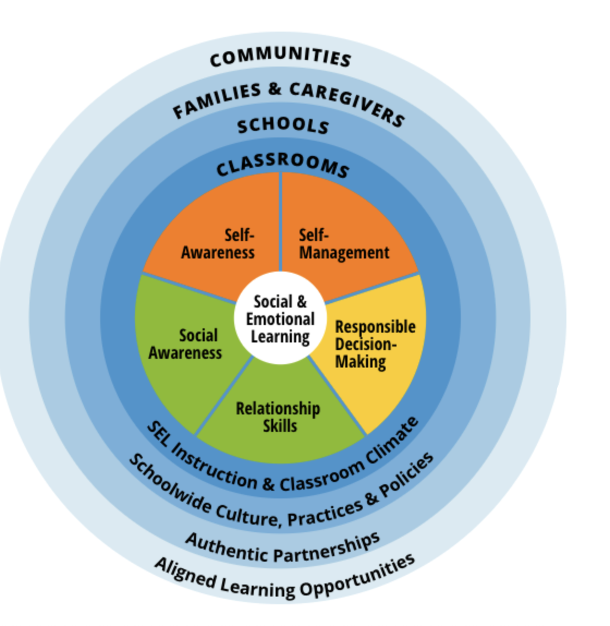
Social-Emotional Competence
(CASEL, 2021)
Self-awareness
  Emotion identification, self-efficacy
Self-management
  Impulse control, emotion regulation
Social-awareness
  Empathy, perspective-taking
Relationship skills
  Communication, teamwork
Responsible decision-making
  Problem-solving, autonomy

Slide 4
Rationale
The preschool years are a key developmental period for building social-emotional skills (Rademacher & Koglin, 2018)
  Response inhibition, theory of mind, perspective-taking
  Understand and identify emotions in themselves and others, adjust emotional responses to different situations, and show increased curiosity about emotions and their causes.
  Social development in cooperation, reciprocity, understanding of behavior expectations
Difficulties manifest in school adjustment, academic performance, persisting social and behavior struggles (Adynski et al., 2025)

Slide 5
Rationale (Cont.)
Children with ASD are more likely to struggle with emotion regulation beginning as early as 12 months (McDonald et al., 2024)
  74% ASD vs. 18% TD
  Built on the foundation of joint attention and social communication
  On average, decreased emotion identification in self and others
Effective learning strategies differ from TD peers (Vivanti & Rogers, 2014)
  Less likely to learn through social learning
  May be disproportionately affected by curricula quality

Slide 6
Research Question
What strategies, or curricula, do preschool special education teachers use with young children diagnosed with autism to promote social-emotional competence and help them control internal and external emotional behaviors that may impact their ability to learn?

Slide 7
Methods
Pilot mixed-method survey study
Participants: Approximately 6-18 special education teachers from six CT districts
Sampling: Initial pool of 30 (10 urban, 10 suburban, 10 rural)
  National Center for Education Statistics (NCES) urban-centric locale classification system.
  Final sample of two districts per category, one preschool per district
Recruitment via email to special education departments

Slide 8
Instrument
Teaching Demographics
Classroom Materials
  Calm-down corner, books, choice boards, emotion wheels
Formal SEL curricula
  Whole-class vs. individually with students with ASD
Methods for teaching CASEL’s social-emotional competencies and effectiveness of strategies
Training, challenges, preparedness

Slide 9
Example Question
Which of the following methods do you use to promote responsible decision-making? (Select all that apply)
Providing structured opportunities for choice-making (e.g. choice boards, centers)
Providing explicit instruction on cause-and-effect relationships
Modeling problem-solving steps during classroom situations
Prompting students to use problem-solving steps when needed
Other
Of these strategies, which do you find to be the most effective for promoting responsible decision-making among students with autism?

Slide 10
Expected Results
Teachers will report a variety of evidence-based strategies that they use with their students with autism and effectiveness will vary by context
Participants may identify barriers such as limited time, insufficient training, and lack of curricula that meets their classroom’s unique needs.
Use findings to develop or evaluate preschool-specific ASD social-emotional curricula or inform targeted professional development

Slide 11
References
Adynski, H., Propper, C., Beeber, L., Gilmore, J. H., Zou, B., & Santos Jr, H. P. (2024). The role of emotional regulation on early child school adjustment outcomes. Archives of psychiatric nursing, 51, 201-211.
Ashiabi, G. (2000). Promoting the emotional development of preschoolers. Early Childhood Education Journal, 28, 79–84.
Collaborative for Academic, Social, and Emotional Learning [CASEL]. (2021a). SEL: What are the core competence areas and where are they promoted?. https://casel.org/sel-framework/
Denham, S. A., Blair, K. A., DeMulder, E., Levitas, J., Sawyer, K., Auerbach-Major, S., & Queenan, P. (2003). Preschool emotional competence: Pathway to social competence. Child development, 74 (1), 238–256.

Slide 12
References (Cont.)
McDonald, R. G., Cargill, M. I., Khawar, S., & Kang, E. (2024). Emotion dysregulation in autism: A meta-analysis. Autism, 28(12), 2986-3001.
Rademacher, A., & Koglin, U. (2019). The concept of self-regulation and preschoolers’ social-emotional development: A systematic review. Early Child Development and Care, 189. 2299-2317.
Vivanti, G., & Rogers, S. J. (2014). Autism and the mirror neuron system: insights from learning and teaching. Philosophical Transactions of the Royal Society B: Biological Sciences, 369(1644).

