Slide 1
An Exploratory Inquiry of Teacher Perceptions of 504 Plans in CT
Jon Bassett and Alex Chester
Notes:
Alex

Slide 2
Background
"Students who do not qualify for special education under the IDEA but are determined disabled under Section 504 of the Rehabilitation Act of 1973 are eligible for accommodations that may include AT devices and/or services. Note that Section 504 uses the term “handicapped” while the IDEA uses the term “disability.” The definition of disability under Section 504 is different from the definition of disability under IDEA. Under Section 504, an “individual with handicaps” is defined as a person who “(i) has a physical or mental impairment which substantially limits one or more major life activities, (ii) has a record of such an impairment, or (iii) is regarded as having such an impairment.” Major life activities include walking, sleeping, seeing, hearing, learning, caring for oneself, performing manual tasks, speaking, breathing, and working (29 U.S.C. §706[8][B]). This means that the definition of individuals with handicaps under Section 504 is broader than the definition of children with disabilities under the IDEA."
Notes:
Civil rights law – intended to make sure that everyone has ‘equal access’
In schools, this has evolved into , full on accommodation plans that is focused on acquisition of content, ie learning, versus access.
Alex

Slide 3
Background (Cont.)
Initially, 504 accommodations aimed to provide equal access to education for students with disabilities by removing barriers to learning
  Over time, the focus has shifted to include more specific academic accommodations tailored to individual student's needs
Evolved to address the unique challenges faced by students with ADHD
  e.g. Difficulty with sustained attention, organization, time management
Increased awareness of mental health issues led to increased need for accommodations to support students with anxiety
  e.g. Extended time on tests, permission to take breaks, access to quiet spaces, deadline flexibility
This evolution reflects a broader understanding of diversity in learning needs and a commitment to providing inclusive education for all students
Notes:
-Clearly a need for 504 plans, but schools are struggling to provide accommodations for all the students on 504 plans.
Alex

Slide 4
Background (Cont.)
IEP Classifications and 504 Classifications:
The 13 categories of disabilities covered under IDEA are: Autism, Specific learning disability, Speech or language impairments, Emotional disturbance, Traumatic brain injury, Visual impairment, Hearing impairment, Deafness, Mental retardation, Deaf-blindness, Multiple Disabilities, Orthopedic impairment, and Other health impairment (deBettencourt, 2002). Specific criteria exists for classification under each of the 13 categories.
Eligibility for education and academic services under Section 504 of the Rehabilitation Act (1973) is generally broader and is often explained as having the existence of an identified physical or mental condition that substantially limits a major life activity (deBettencourt, 2002).
Notes:
Alex

Slide 5
Evaluation of 504 Case Management
The role of a school counselor in the 504 process may vary from state to state, district to district and even building to building. The school counselor’s primary role is to be an advocate for students in this process.
The school counselor’s job is to start the 504-evaluation process once a referral is received. Accommodations may help this student access their education and prevent exclusion or discrimination based on an impairment.
Notes:
In previous years, Dr. Renzulli and LEND students have looked at different ways school counselors interact with 504, but have not examined how classroom teachers interact with 504 plants.
Classroom teachers play a central role in the implementation of
Section 504 academic plans. Because teachers are responsible for delivering instruction and assessing
student performance, they are often the professionals most directly responsible for ensuring that
accommodations outlined in a 504 Plan are implemented consistently and effectively
Little research has been conducted on teacher perceptions of implementing 504 plans.
The proposed study aims to better understand this missing perspective from the literature.
Alex

Slide 6
Research Question
What are teachers’ training, perceptions, understanding of Section 504 academic support plans?
Notes:
Jon

Slide 7
Methodology
One-time, online, anonymous survey which will be distributed via email teachers in CT
Survey is conducted online via Qualtrics that will take approximately 15 minutes
Data is analyzed quantitatively and qualitatively to identify common themes and patterns across responses
Notes:
Jon

Slide 8
Sample
The sample will be a convenience sample from 2 school districts in the state
Convenience sampling is a non-probability sampling method in which participants are selected based on accessibility and willingness to participate (Creswell & Poth, 2018)
14 people submitted a survey; 7 responses were more complete
Notes:
Reached out to subject area teachers from internship sites -
Jon

Slide 9
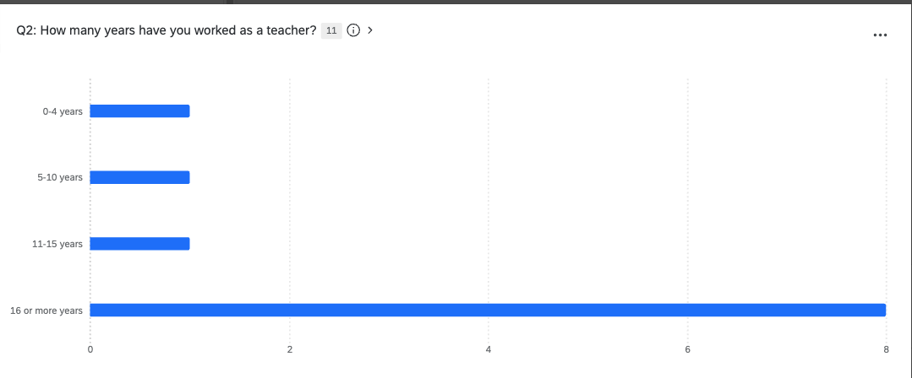
Table of survey respondents
Notes:
Jon

Slide 10
Characteristics of survey respondents
Subjects taught (n=7) | Grade level taught (n=7) | Number of students taught per year (n=7)
Science/Biology | High school | 3 respondents teach between 51-99 students
Italian and French |  | 4 respondents teach 100 or more students per year.
Mathematics
Art
Notes:
Jon

Slide 11
Teacher Training on Section 504
Notes:
Jon 18-23

Slide 12
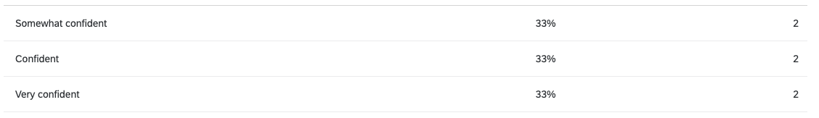
Q9: How confident are you in your knowledge of the legal requirements related to section 504?
Notes:
-indicates a lack of formal training
-limited guidance?

Slide 13
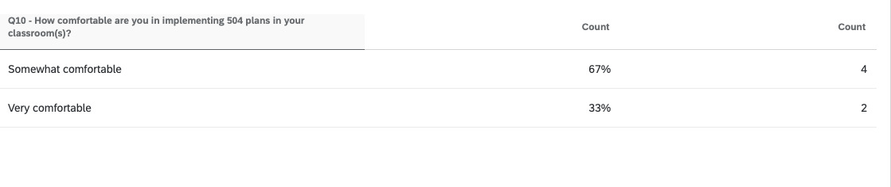
Q10: How comfortable are you in implementing 504 plans in your classroom?

Slide 14
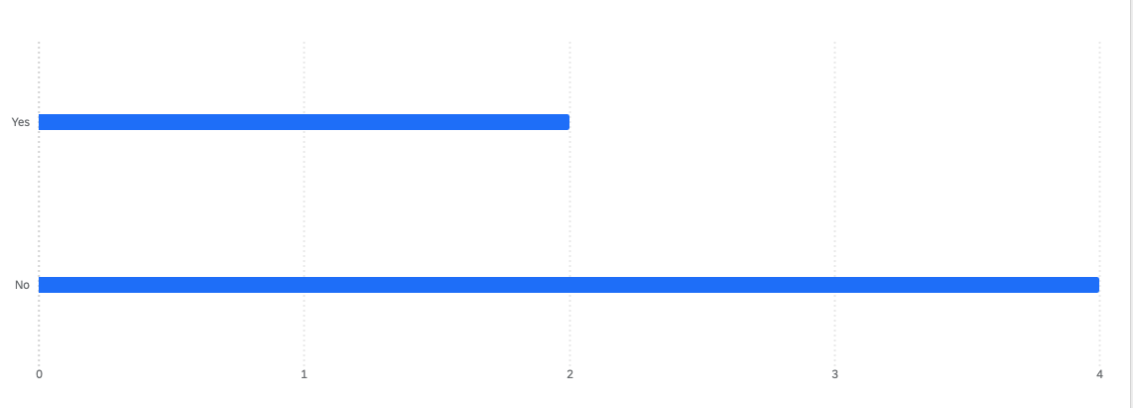
Q19: As part of your own teacher preparation program (academic training) did you receive training on 504 plans?
Notes:
In general – respondents did not feel 504 training was adequate
-Some respondents said they reiceved prof dev. On 504s. Other indicated it was discussed in their grad programs, more focus in special ed, IEP

Slide 15
Key Takeaways
"Providing individual training on all of that would take much longer than we have. Having time for special education teachers to meet with teachers prior to the start of each semester would be a good start. The paperwork they send gives some of the information but having time to discuss student needs in person would be better."
"There has been limited quality PD offered and more importantly, not enough support in implementing some of the accommodation plans."
Notes:
Jon
There was another comment that mentioned "I am so old, we were never taught this."
-Teachers want collaboration
-Relationships
-Ongoing training?

Slide 16
Teacher Perceptions / Understanding of Section 504
Notes:
Alex 11-17

Slide 17
Q7: What is the purpose of a 504 plan?
Responder | Response
Responder 1 | A plan for a student that may need additional supports than what is typically provided by a classroom teacher. They may not qualify for special education services but their needs could be met with these additional supports in place.
Responder 2 | To provide accommodations for students who need it based on medical/mental health diagnoses
Responder 3 | It is a legally binding plan that provides accommodations for students who have physical or mental impairments that limits their ability to achieve academically (they may have difficulty concentrating, may need accommodations for medical needs, or may need supports for how they learn).
Responder 4 | To provide support for students who are "other health impaired" who don't qualify for Special Education Services.
Responder 5 | To provide accommodations for students with varying needs
Notes:
Alex
Talk about similarities and differences, rather than reading responses
5 responses – as you can see above.
R1 / R4 – discussed providing accommodations for students who do not qualify for SPED
3 respondents talked about providing accommodations
General agreement about purpose of 504 – less agreement about the population it should serve. Some respondents discuss students who have a diagnosis, other say ‘varying needs’
Congruity – all talked about providing
Incongruity – population that they serve – then talk about which ones talked about needing a medical/mental health diagnosis, and
This is the challenge with 504 –
Also – teacher perspective vs SC perspective

Slide 18
Q8: In your opinion, what should qualify a student for a 504 Plan?
Responder | Response
Response 1 | Physical impairments (vision, hearing, mobility), attention deficit disorders, executive functioning issues/challenges.
Response 2 | A health issue that would affect a students ability to come to school and learn.
Response 3 | Medical issues that require frequent breaks or monitoring by the nurses.
Response 4 | Any student who's educational needs are not being met as a result of their physical or mental impairment.
Response 5 | Medical/Mental Health issues.
Response 6 | any student with a condition that inhibits them from learning with only tier 1 instruction.
Notes:
R1/2/3/5 all discuss medical issues but link to functional challenges
R4/6 more broad that discuss students experiencing educational needs. 6 is particularly interesting because they brought in MTSS
Teachers talk more about the medical side for 504.
Are students with neurodevelopmental plans using them?
Are the plans more like security blanket – nice to have not necessary?
TAKEAWAY – SC perspective vs. teacher perspective

Slide 19
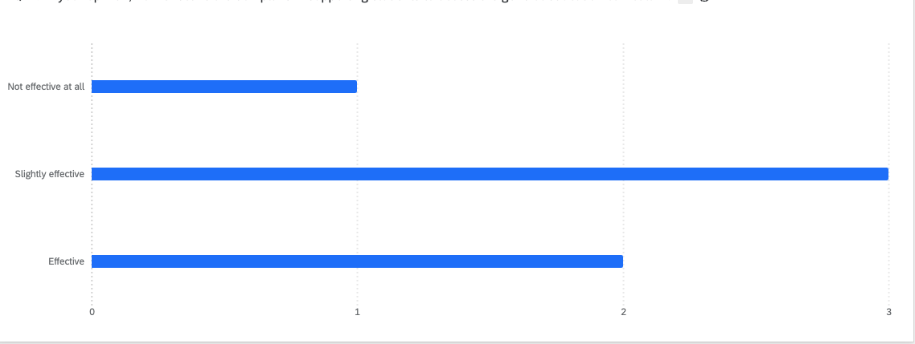
Q14: In your opinion, how effective are 504 plans in supporting students to access the general education curriculum?

Slide 20
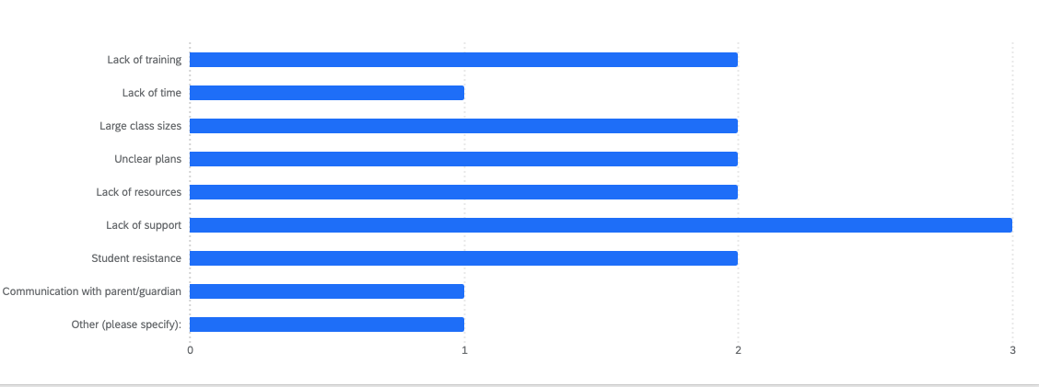
Challenges with 504
4 of the 6 respondents reported experiencing challenges with implementing 504 plans

Slide 21
Q18: Is there anything else you would like to share about your experiences with 504 plans?
Responder | Response
1 | No thank you.
2 | There are many students who take advantage of their plans and use it as a crutch in learning. Many students use the alternative setting for tests as an excuse to leave the room and take the class in a support room that may not be the best place for them because they need the support of the classroom teacher to take the assessment. Many times, the students use this as an opportunity to cheat on assessments.
3 | 504's are a very convoluted area that are not closely monitored or regulated.
4 | Many times, I feel like the 504 plans are created without considering what the student actual needs.

Slide 22
Q18: Is there anything else you would like to share about your experiences with 504 plans? (cont.)
Responder | Response
5 | Too often accommodations become a crutch, especially when it comes to extended time. Extended time does not mean UNLIMITED time. For example, 50% extra time. We need to work on getting students to advocated for themselves and not use accommodations as an excuse.
6 | I have 7-8 students per class period with either a 504 or IEP plan, teaching elective courses at a high school. Providing individual training on all of that would take much longer than we have. Having time for special education teachers to meet with teachers prior to the start of each semester would be a good start. The paperwork they send gives some of the information but having time to discuss student needs in person would be better.

Slide 23
Key Takeaways
School Counselors vs. Teachers understanding/focus of 504 plans
General agreement about purpose of 504, but less agreement about the population it should serve
Agreement on providing accommodations
We saw varying opinions on the effectiveness of 504 plans
Teachers provided ideas to address challenges: Q18 R6

Slide 24
General Conclusions
“Too often accommodations become a crutch, especially when it comes to extended time. Extended time does not mean UNLIMITED time. For example, 50% extra time. We need to work on getting students to advocated for themselves and not use accommodations as an excuse.”
Notes:
Jon
Conclusions based on all key takeaways
-How much accommodation is too much accommodation?
-More education and training is required for 504s

Slide 25
Next Steps for LEND Trainees
Consider how to educate / collaborate / train teachers
Further research to establish a systematic process for 504 plan initiation and review
Further research on similarities and differences in teacher vs. School counselor / school psych / school social worker perceptions of 504 plans
Notes:
Alex
What should LEND people know?
Add more to this slide

Slide 26
References
Baldwin, J., & Kroesch, A. M. (2025). Need Help at School: Develop a 504 Plan with Your Team. Research, Advocacy & Practice for Complex & Chronic Conditions: Journal for Physcial, Health & Multiple Disabilities Services (RAPCC), 43(1), 10–14. https://doi-org.ezproxy.lib.uconn.edu/10.14434/rapcc.v1i43.39523
Burke, M. M., Mercer, C., Ramos-Torres, S., Lindsay, R., & Burakov Burakov Burakov, I. (2025). Frequently Asked Questions and Answers for Supporting Students With Section 504 Plans. Intervention in School & Clinic, 60(4), 214–219.
https://doi-org.ezproxy.lib.uconn.edu/10.1177/10534512241297322
Creswell, J. W., & Poth, C. N. (2018). Qualitative inquiry and research design: Choosing among five approaches (4th ed.). Sage.

Slide 27
References (Cont.)
deBetterncourt, L.U. (2002). Understanding the differences between IDEA and section 504. Teaching Exceptional Children 34(3), 16-23. http:/doi.org/10.1177/004005990203400302
Lindsay, R., Joshi, B., Abaza, N., Smith, B. C., Ramos-Torres, S., Humphries, R., Demissie, S., Hincapie, A. L., Burakov, I., Goscicki, B., & Burke, M. M. (2025). Exploring Family Experiences With Section 504 Plans for Their Autistic Children. Journal of Autism & Developmental Disorders, 1–12.
https://doi-org.ezproxy.lib.uconn.edu/10.1007/s10803-025-06856-2
Spiel, C. F., Evans, S. W., & Langberg, J. M. (2014). Evaluating the Content of Individualized Education Programs and 504 Plans of Young Adolescents With Attention Deficit/Hyperactivity Disorder. School Psychology Quarterly, 29(4), 452–468.
https://doi-org.ezproxy.lib.uconn.edu/10.1037/spq0000101

